Slide 1

Use python to devolope a snake game
Supervised by :
dr: hussein elshafeay
dr : Omar atef

Slide 2


Project Members
Mamdoh Marof Abdulrazak
Mahmoud Mohamed Fouad

Slide 3
Snake game
About Snake game
the snake game is a game which played with keyboard to make the snake which appeare in the scereen move in the four directions to eat the appeles that will be in the screen too and try to achive a high score in the game

Slide 4

Keys to play the game
W
up
A
S
D
left
Down
Right

Slide 5
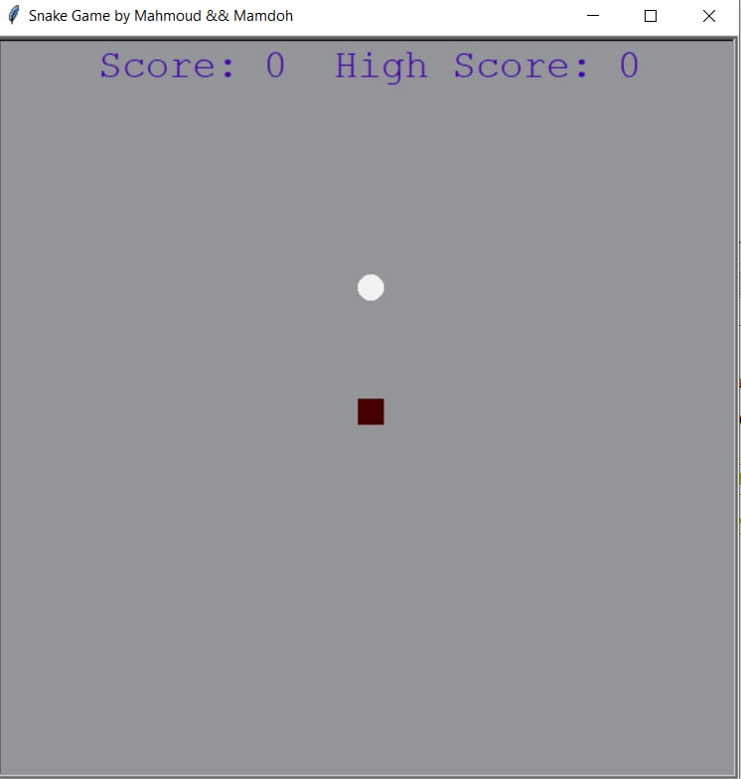
Snake game start

Slide 6
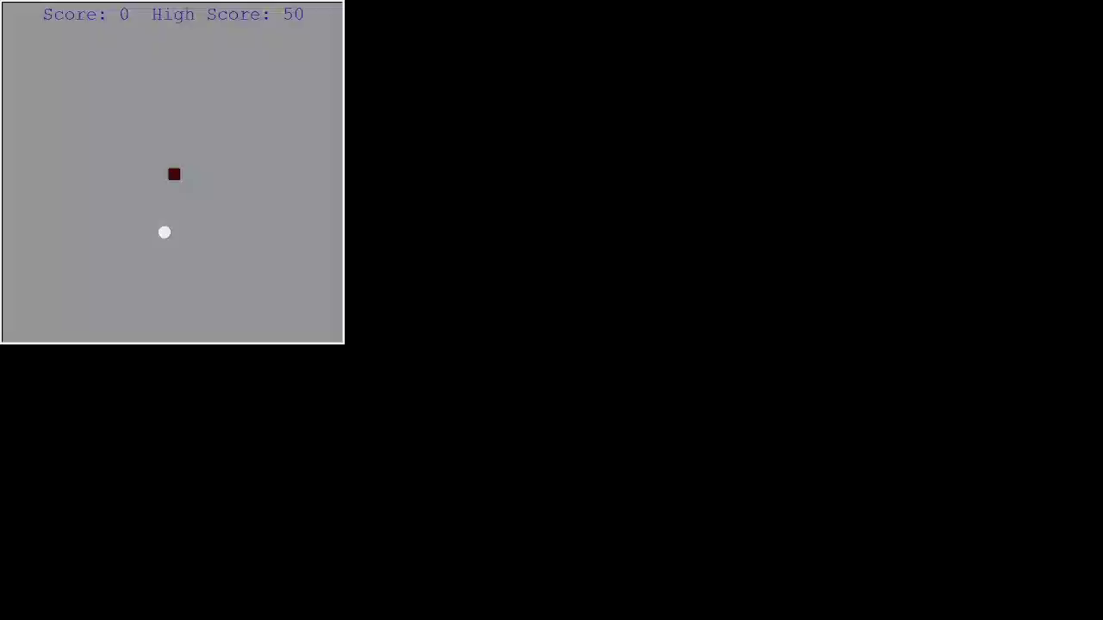
Playing Snake Game

Slide 7
Thank you

